Slide 1

ATLIQ SUPPLY CHAIN & FINANCE ANALYTICS

Slide 2
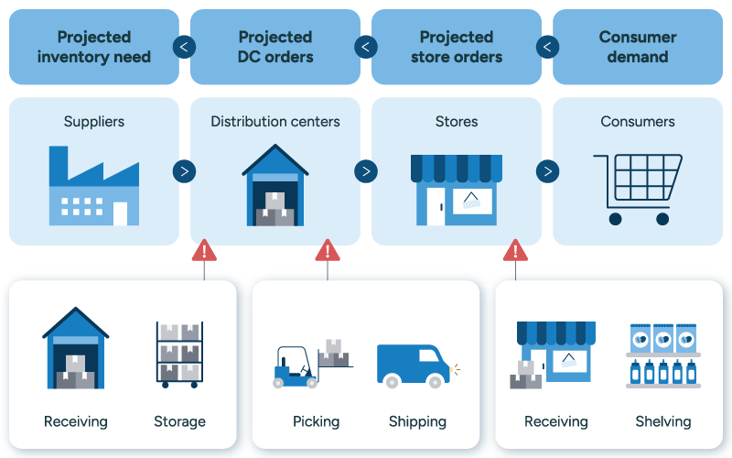
INTRODUCTION
AtliQ operates in the hardware manufacturing and distribution environment, selling products such as mouse, keyboards, laptops and other electronic devices through direct, retail and distributor channels. The project applies SQL-based finance and supply-chain analytics to connect sales, customer, product, pricing, cost, freight, deductions, inventory and forecast information into management-oriented insights.

Slide 3
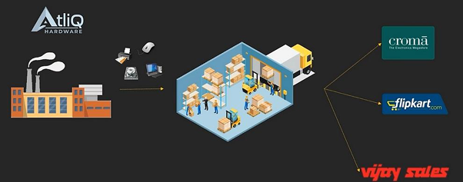
BUSINESS OBJECTIVE
  Improve demand planning and identify forecast bias.
  Understand customer and product concentration.
  Evaluate profitability and discount impact.
  Identify freight and inventory efficiency opportunities.
  Create a repeatable SQL analytics framework for management reporting.

Slide 4
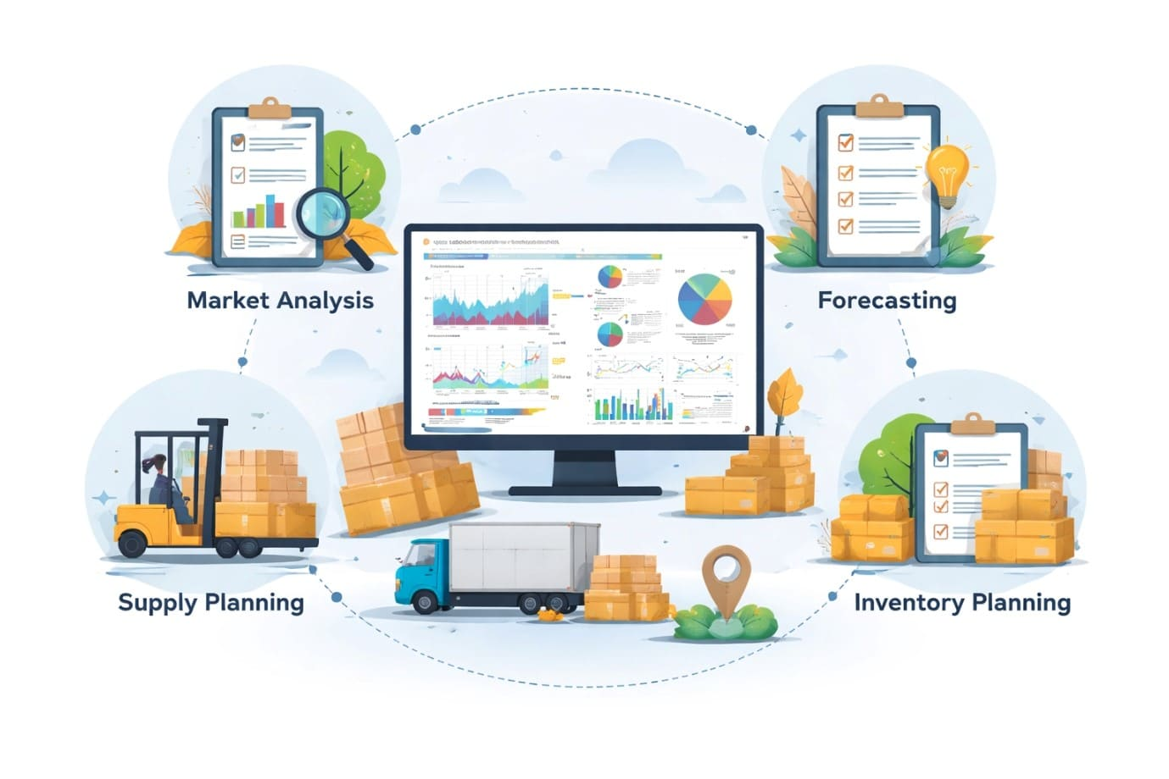
METHODOLOGIES
  Build and validate relational data model.
  Join fact and dimension tables.
  Calculate sales, revenue, cost and margin KPIs.
  Apply customer/product/market comparisons and window functions.
  Evaluate forecast variance and inventory movement.
  Convert SQL outputs into business actions and data requirements.

Slide 5
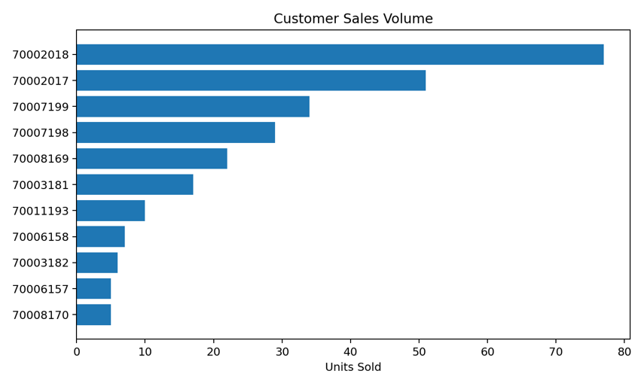
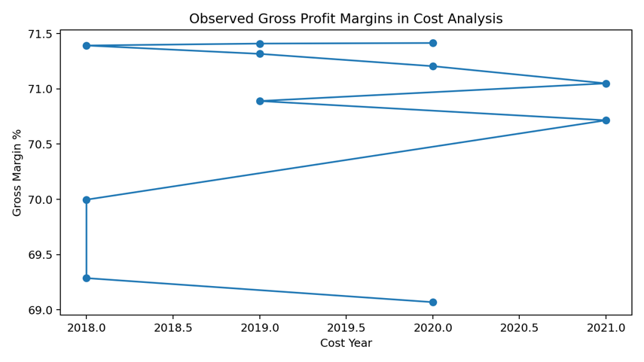
Sales & Customer Performance
Product A0118150101 records 263 observed units and 4,048.94 gross revenue.
Customer 70002018 is the largest observed customer by both units and gross revenue.
70002018 contributes about 29.3% of observed unit sales.
The sample contains limited repeat-purchase evidence, so concentration and loyalty should be monitored as the dataset expands.
Profitability & Cost
Observed product-year gross margins range from approximately 69.07% to 71.41%.
A0118150101 reports 70.00% margin in 2018, 70.89% in 2019, 69.07% in 2020 and 71.05% in 2021.
The margin band is relatively stable, but annual cost and price movements should continue to be monitored.
For the top observed product, estimated gross profit is 2,834.14.

Slide 6
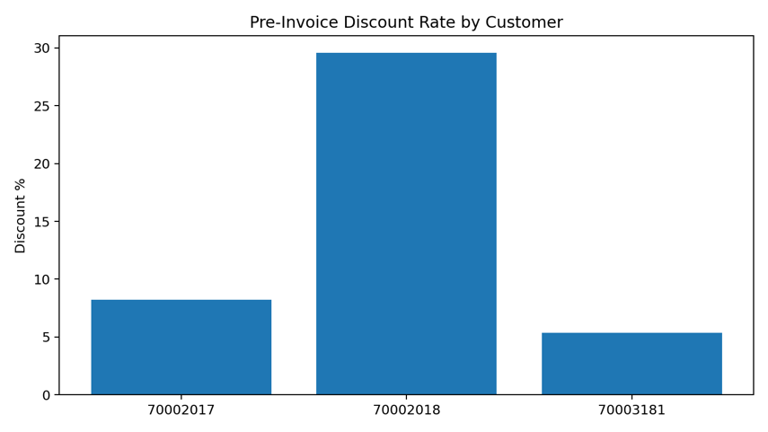
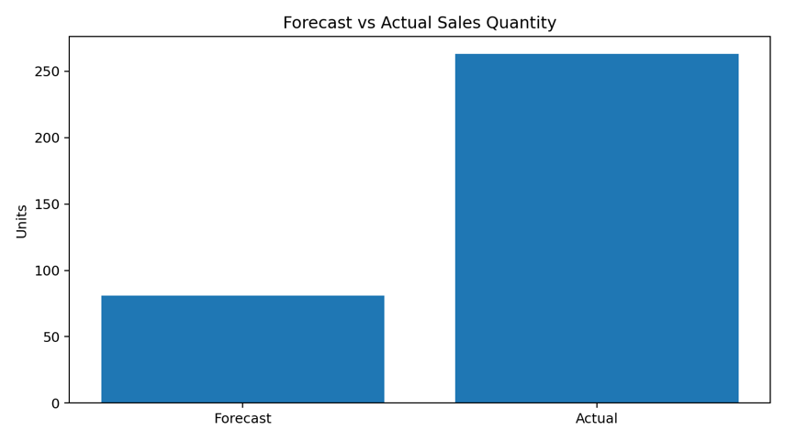
Discount Impact
Customer 70002018 has the highest listed pre-invoice discount rate: 29.56%.
The reported discount amount is 350.41 against gross revenue of 1,185.43.
Net invoice revenue after the deduction is 835.02.
Discount governance should link concessions to volume, margin and strategic account value.
Forecast vs Actual — Critical Finding
Forecast quantity: 81 units.
Actual quantity: 263 units.
Variance: +182 units.
Project formula: Actual ÷ Forecast × 100 = 324.69%.
Interpretation: actual demand was substantially above forecast; the planning process under-estimated demand.
Important: 324.69% is an actual-to-forecast ratio, not a conventional forecast-accuracy score.

Slide 7
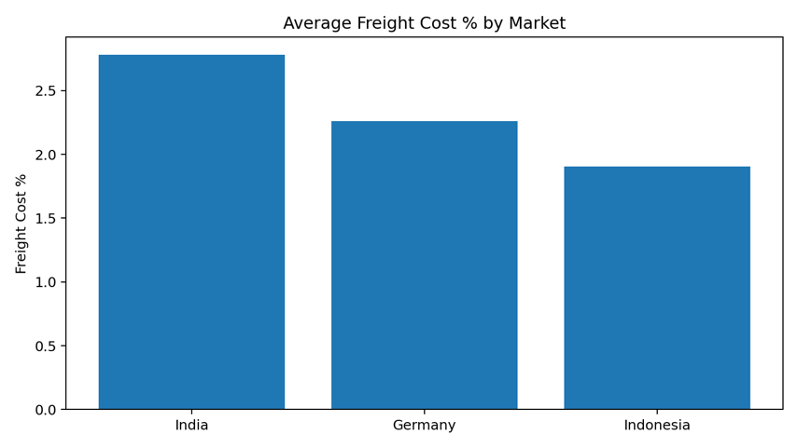
Freight & Logistics
India: 2.78% average freight cost — highest among the three listed markets.
Germany: 2.26%.
Indonesia: 1.91%.
Use route, carrier and service-level data to determine whether the difference is structural or volume-related.
Customer-Level Forecast Variance
Inventory & Customer Loyalty
70008169: forecast 2 vs actual 22 → +20 units.
70007198: forecast 4 vs actual 29 → +25 units.
70007199: forecast 7 vs actual 34 → +27 units.
70002018: forecast 11 vs actual 77 → +66 units — the largest absolute variance.
70008170 is the only listed customer below forecast: 8 forecast vs 5 actual.
A0118150101: inventory 1,000, sales 263, simple turnover proxy 0.263.
A0118150102 and A0118150103: 1,000 inventory each with no observed sales — classified as slow/no movement.
All 11 observed active support customers are classified as Low Loyalty.
Each has one observed purchase month and one fiscal year with purchases.
Interpret carefully because the sample is limited.

Slide 8

KPI SNAPSHOT
263
4,048.94
81
263
observed units sold
observed gross revenue
forecasted units
actual units
69% - 71%
182
1,185.43
Actual demand was 182 units above forecast
Revenue from top observed customer (70002018)
Observed gross margins in the cost analysis

Slide 9

KEY INSIGHTS
01
02
03
Demand forecasting is the clearest operational improvement opportunity.
Observed sales are heavily concentrated in one product and one market/channel.
High-volume customer 70002018 also carries a relatively high discount rate.
04
05
06
Observed gross margins are strong and comparatively stable in the available cost records.
Inventory should be differentiated between active and non-moving products.
Customer retention evidence is weak in the current sample.

Slide 10

RECOMMENDATIONS
01
02
Recalibrate forecasts using customer-product history and rolling actual demand.
Track forecast bias, MAE/MAPE or WAPE alongside the project's actual-to-forecast ratio.
03
04
Review high discounts against volume and contribution margin.
Prioritize replenishment for demonstrated demand and investigate non-moving inventory.
05
06
Build retention/reorder triggers for high-volume accounts.
Investigate freight drivers in India.
07
Add missing CAC, competitor, satisfaction and campaign datasets.

Slide 11

LIMITATIONS
CAC cannot be calculated without acquisition spend and acquired-customer data.
Inventory turnover needs historical inventory snapshots for a stronger measure.
Customer satisfaction needs feedback/survey data.
Competitor benchmarking needs competitor price/product data.
Marketing effectiveness needs campaign, spend and response data.
Expand the historical dataset before making enterprise-wide strategic conclusions.

Slide 12


CONCLUSION
The project demonstrates an end-to-end SQL analytics framework connecting finance and supply-chain decisions.
The strongest observed signal is substantial under-forecasting of demand. Discount management, product/inventory focus and customer retention are additional decision areas.
With richer historical and commercial data, the model can be extended into a recurring management dashboard.

Slide 13
THANK
YOU

